Slide 1

APEX INSTITUTE OF TECHNOLOGY
DEPARTMENT OF COMPUTER SCIENCE & ENGINEERING
Computer Organization & Architecture (21CSH-281)
Faculty: Siddharth Kumar (E12853)
Lecture - 13
Computer Arithmetic: Booth Multiplier
DISCOVER . LEARN . EMPOWER

Slide 2
Computer Organization & Architecture: Course Objectives
COURSE OBJECTIVES
The course aims to:
The purpose of the course is to introduce principles of computer organization and the basic architectural concepts.
It begins with basic organization, design, and programming of a simple digital computer and introduces simple register transfer language to specify various computer operations.
Topics include computer arithmetic, instruction set design, microprogrammed control unit, pipelining and vector processing, memory organization and I/O systems, and multiprocessors.
To familiarize Students with the detailed Architectures of a Central Processing Unit.
Learn the different types of serial communication techniques.

Slide 3
COURSE OUTCOMES
On completion of this course, the students shall be able to:-
CO1 | Identify and interpret the basics of instruction sets and their impact on the design, organization, and functionality of various functional units of a computer comparable to the CPU, memory organization, I/O organization, and parallel processors.
CO2 | Analysis of the design of arithmetic & logic unit and understanding of the fixed point and floating-point arithmetic operations.
CO3 | Relate cost performance and design trade-offs in designing and constructing a computer processor which includes memory.
CO4 | Understanding the different ways of communicating with I/O devices and standard I/O interfaces.
CO5 | Implementation of control unit techniques and the concept of Pipelining.

Slide 4
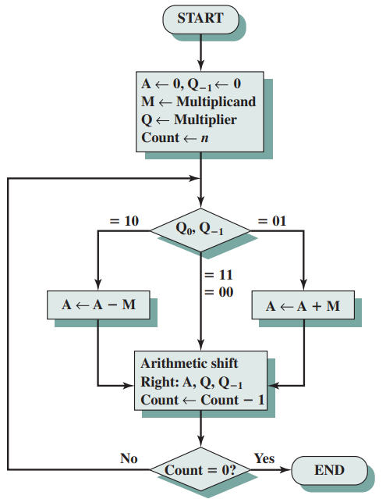
Booth Multiplier
Working of booth multiplier is based on the concept of Booth's multiplication algorithm is an algorithm which multiplies 2 signed integers in 2's complement. This approach uses fewer additions and subtractions than more straightforward algorithms.
Booth’s algorithm is depicted in figure and can be described as follows. As before, the multiplier and multiplicand are placed in the Q and M registers, respectively. There is also a 1-bit register placed logically to the right of the least significant bit (Q₀) of the Q register and designated Q₋₁; its use is explained shortly.
The results of the multiplication will appear in the A and Q registers. A and Q₋₁ are initialized to 0. As before, control logic scans the bits of the multiplier one at a time. Now, as each bit is examined, the bit to its right is also examined.
Figure: Twos Complement Multiplication

Slide 5
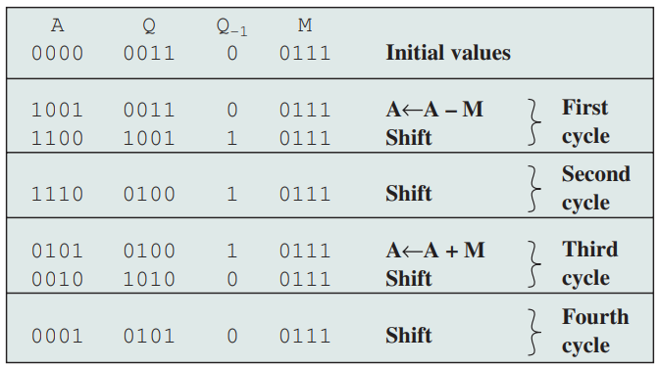
If the two bits are the same (1–1 or 0–0), then all of the bits of the A, Q, and Q₋₁ registers are shifted to the right 1 bit. If the two bits differ, then the multiplicand is added to or subtracted from the A register, depending on whether the two bits are 0–1 or 1–0.
Following the addition or subtraction, the right shift occurs. In either case, the right shift is such that the leftmost bit of A, namely A_{n-1}, not only is shifted into A_{n-2}, but also remains in A_{n-1}. This is required to preserve the sign of the number in A and Q. It is known as an arithmetic shift, because it preserves the sign bit.
Figure (Example of Booth’s Algorithm (7 * 3)) shows the sequence of events in Booth’s algorithm for the multiplication of 7 by 3.
More compactly, the same operation is depicted in Figure (Examples Using Booth’s Algorithm (a)) in next page.
The rest of Figure (Examples Using Booth’s Algorithm) gives other examples of the algorithm.
Figure: Example of Booth’s Algorithm (7 * 3)

Slide 6
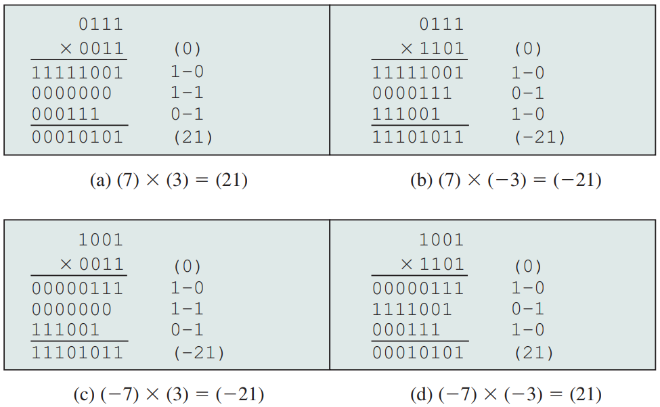
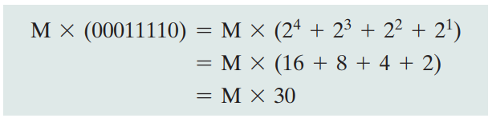
As can be seen, it works with any combination of positive and negative numbers. Note also the efficiency of the algorithm. Blocks of 1s or 0s are skipped over, with an average of only one addition or subtraction per block.
Why does Booth’s algorithm work? Consider first the case of a positive multiplier. In particular, consider a positive multiplier consisting of one block of 1s surrounded by 0s (e.g., 00011110). As we know, multiplication can be achieved by adding appropriately shifted copies of the multiplicand:
Figure: Examples Using Booth’s Algorithm
The number of such operations can be reduced to two if we observe that:
2^{n} + 2^{n-1} + ………. + 2^{n-K} = 2^{n+1} - 2^{n-K}

Slide 7
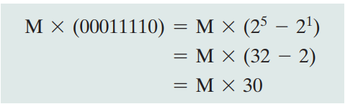
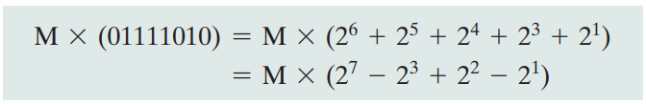
So the product can be generated by one addition and one subtraction of the multiplicand. This scheme extends to any number of blocks of 1s in a multiplier, including the case in which a single 1 is treated as a block.
Booth’s algorithm conforms to this scheme by performing a subtraction when the first 1 of the block is encountered (1–0) and an addition when the end of the block is encountered (0–1).
To show that the same scheme works for a negative multiplier, we need to observe the following. Let X be a negative number in twos complement notation:
Representation of X = {1x_{n-2}x_{n-3} …. x₁x₀}

Slide 8
Design Issues
Booth's algorithm can be implemented in many ways. This experiment is designed using a controller and a Datapath. The operations on the data in the Datapath is controlled by the control signal received from the controller. The Datapath contains registers to hold multiplier, multiplicand, intermediate results, data processing units like ALU, adder/subtractor etc., counter and other combinational units. Following is the schematic diagram of the Booth's multiplier which multiplies two 4-bit numbers in 2's complement of this experiment. Here the adder/subtractor unit is used as data processing unit. M, Q, A are 4-bit and Q-1 is a 1-bit register. M holds the multiplicand, Q holds the multiplier, A holds the results of adder/subtractor unit.
The counter is a down counter which counts the number of operations needed for the multiplication. The data flow in the data path is controlled by the five control signals generated from the controller. these signals are load (to load data in registers), add (to initiate addition operation), sub (to initiate subtraction operation), shift (to initiate arithmetic right shift operation), dc (this is to decrement counter). The controller generates the control signals according to the input received from the Datapath. Here the inputs are the least significant Q0 bit of Q register, Q-1 bit and count bit from the down counter.

Slide 9
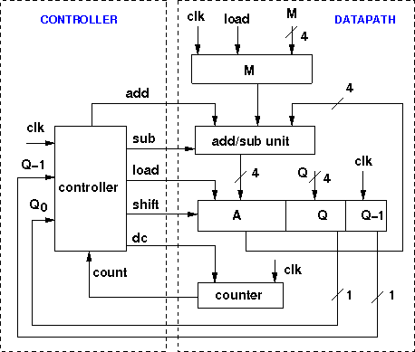

Slide 10
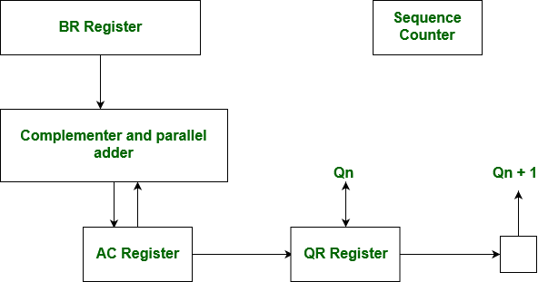
Hardware Implementation of Booth’s Algorithm
The hardware implementation of the booth algorithm requires the register configuration shown in the figure below.

Slide 11
Summary
Discussed about Booth's multiplication algorithm.
Discussed the working mechanism of Booth's multiplication algorithm.
We see that Booth’s algorithm conforms to this scheme. It performs a subtraction when the first 1 is encountered (10), an addition when (01) is encountered, and finally another subtraction when the first 1 of the next block of 1s is encountered. Thus, Booth’s algorithm performs fewer additions and subtractions than a more straightforward algorithm
Assessment Questions
Q1. Given x = 0101 and y = 1010 in twos complement notation (i.e., x = 5, y = -6), compute the product p = x × y with Booth’s algorithm.
Q2. Use the Booth algorithm to multiply 23 (multiplicand) by 29 (multiplier), where each number is represented using 6 bits.

Slide 12
THANK YOU

